Slide 1
Quality Improvement, Evidence-Based Practice, and Research
Student’s Name
Institutional Affiliation

Slide 2
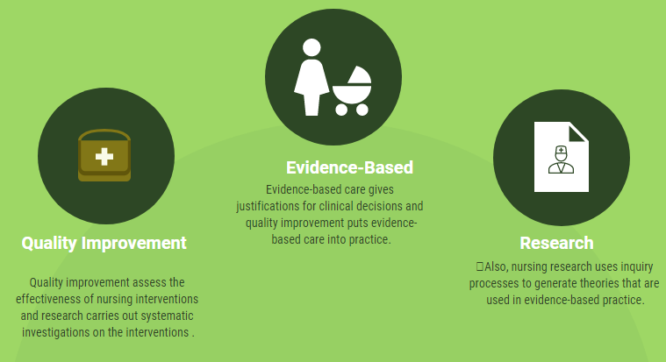
Similarities

Slide 3

Differences

Slide 4

Example of Evidence-Based Practice

Slide 5

Example of Quality Improvement

Slide 6

Example of Nursing Research

Slide 7

Importance of Quality Improvement

Slide 8

Cont.

Slide 9

Importance of Evidence-Based Practice

Slide 10

Cont.

Slide 11

Importance of Research

Slide 12
References
Fitzpatrick, J. J. (2015). Distinctions between research, evidence-based practice, and quality improvement. Applied Nursing Research, 29(1), 261.
North Dakota Center for Nursing. (2014). Comparison of quality improvement, evidence-based practice, and nursing research. 1-5.

